Slide 1
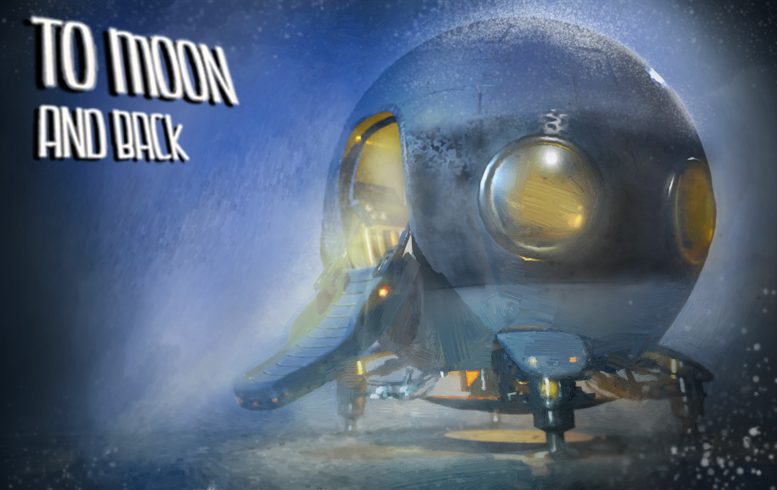
“To Moon and back” Infinite scroller
SAE921-GPR4100-CPlusPlus-Class-Sstyles-Box2D

Slide 2
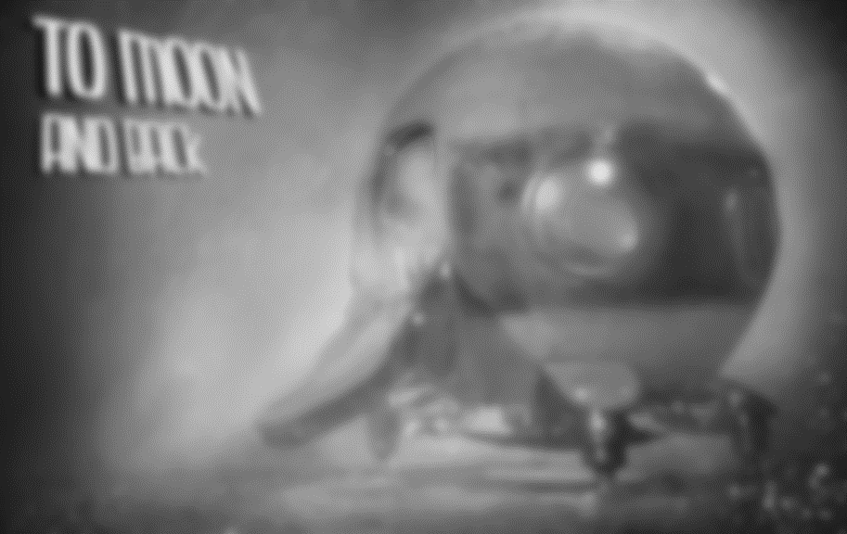
The “Game Design”
Game Design: The basic game design is an Infinite scroller, a game in which the end is only defined by the players death
Inspiration : Space Invaders. (Visual)
Into Space (Mechanics)
Goal: Stay alive as long as possible

Slide 3
Game Problems:
- Saved score
- Start menu (start game, options, quit)
-End menu ( restart, quit)
Game Improvements:
- Graphical Improvements.
- Sound Improvements.
- Game Mechanics (Character actions, ex: shooting ?).
- Game difficulty ( improve difficulty over time).

Slide 4
Hierarchy :
-Main : Contains the [Game] :
Game Constructor, Initialization and Loop.
-Game : Contains All the the game elements:
-Constructor :
World & Gravity, Character, Contacts, trailManager, Music, Sound, Text.
-Init(): Initializes the Window, Window limits (boundaries)
BackGround elements, Game elements, UiElements
-Loop(): The loop is responsible for running the game
It is segmented in three parts : Event Process,
Physical Process, Graphical Process
There are also Contact & Conversion Methods in the Game Class. Those are responsible for modifying objects values on contact, and dealing with transitions of units between SFML & Box2D.

Slide 5
Hierarchy :
-Classes : The Classes contain all the elements and methods to create the “Objects” (SFML & Box2D)
-Constructor : The “Ctor” loads the sprites and basic elements
-Init(): Initializes the SFML & Box2D Elements.
-Update() : Updates the physical & graphical positions
-Draw() : Draw all the elements.
Basically all the classes have the same hierarchy EXCEPT : ContactListener, TextureManager, SMFL_Utilities, UserData.
Those are SPECIAL CLASSES used for Conversion & Contact.

Slide 6
Thank you for listening !

Slide 7
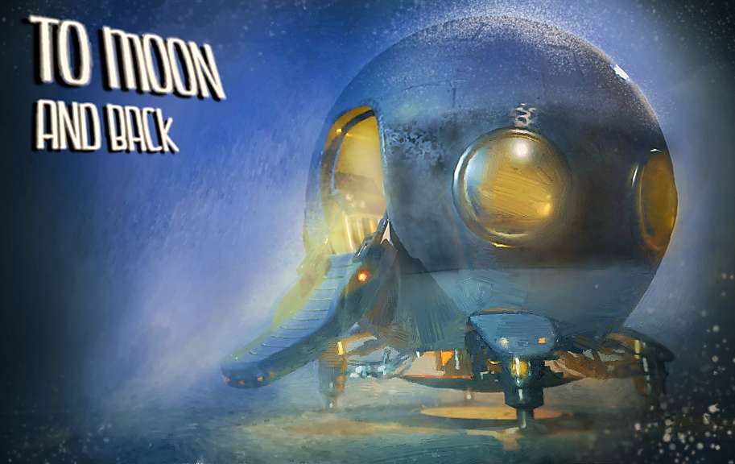
NOW LETS PLAY !!! :D

